Slide 1
TurtleStitch
Making repeating designs and
design for backing material
Hans de Jong
12 July 2026

Slide 2
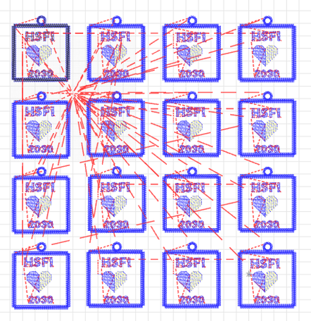
Making repeating designs
The original that
Susan Ettenheim requested
help for
(also note the jump stitches)

Slide 3
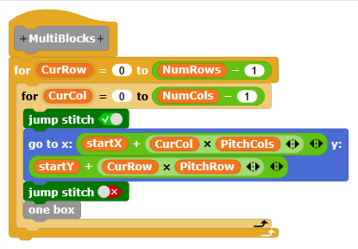
How to make designs with multiple repeating subdesigns
Make a single design that is only using relative coordinates (only relative to a startingpoint)
Use nested for blocks
to create the multiple
designs in rows and
columns

Slide 4
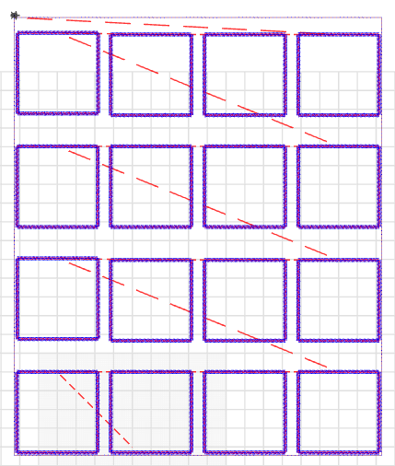
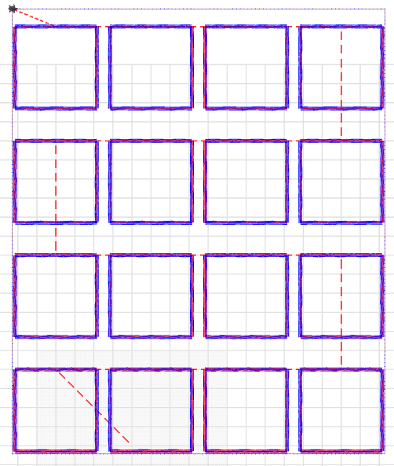
Avoiding long jump stitches
Instead of this ...
… do this

Slide 5
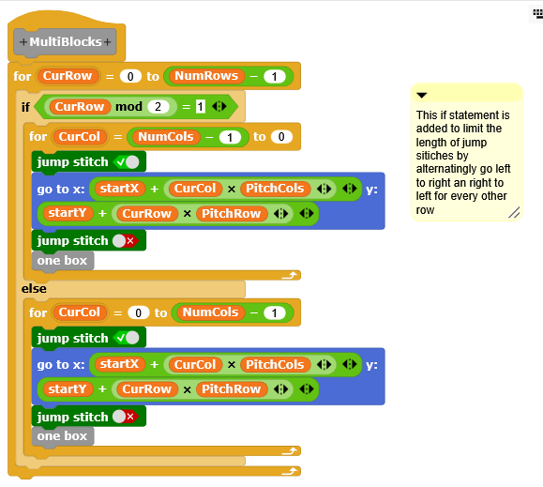
Therefore this is the code for moving through rows and columns

Slide 6
Using backing material: the intent
Hide the jump stitches at the back of the fabric
It goes like this:
  Embroider the first part of the design
  Let the embroidery machine stop
  Tape a piece of fabric to the back of the hoop
  Embroider a second part on both front and back together
  Issues:
    How to design the second part?
    How to position it at the exactly the right place?

Slide 7
Get first and second design out of a single TurtleStitch program
Use a switch in the design to determine which elements to include

Slide 8
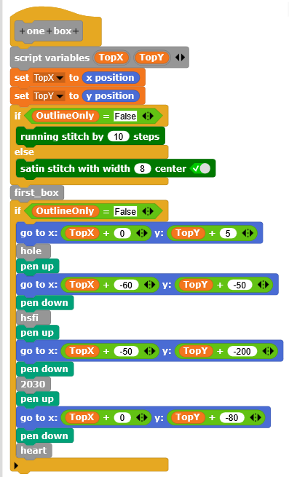
Remember the start position
Always embroider the box (first_box), the stitch type depends on OutlineOnly being True or False
Skip the next elements if designing only the outline
Do all gotos relative to the start position

Slide 9
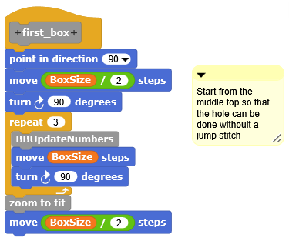
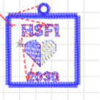
One more jump stitch avoidance:
Start the box on the middle top
Avoid this jump stitch
Start and end
Start and end
We will talk about BBUpdateNumbers later
Original
New

Slide 10
With the OutlineOnly flag the design can be steered
It can be steered to create
  The first part
  The second part or
  Both parts in a single design by changing OutlineOnly in the mean time.
    Make the first design and the second design in separate colors
    This makes the machine stop after the first design so that you can put the fabric to the back

Slide 11
Issue when making a separate first and second design
The size of the first and second part will be different
  Leading to the machine placing the design at slightly different places
  Unless ...

Slide 12
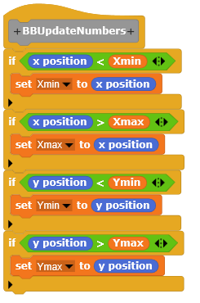
Make a bounding box
Record the minimum and maximum positions
The bounding box at the outside is the same for both the first and the second design.
“Embroider” the bounding box in a different color so that the machine stops. Then do not embroider, but load the second design which will now be embroidered at the right place.

Slide 13
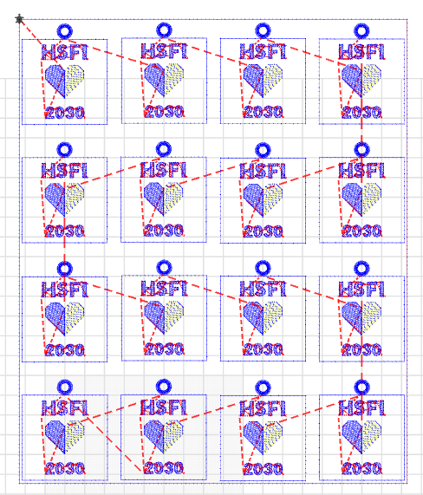
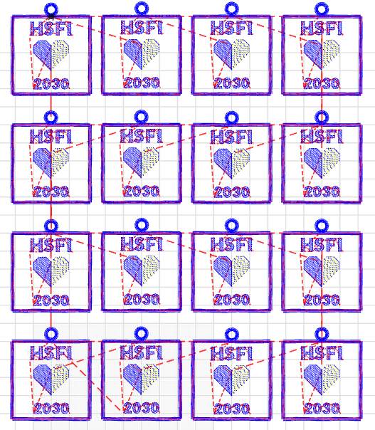
Result
Same bounding box
Same bounding box
No bounding box needed
First design
Second design
Combined design

Slide 14
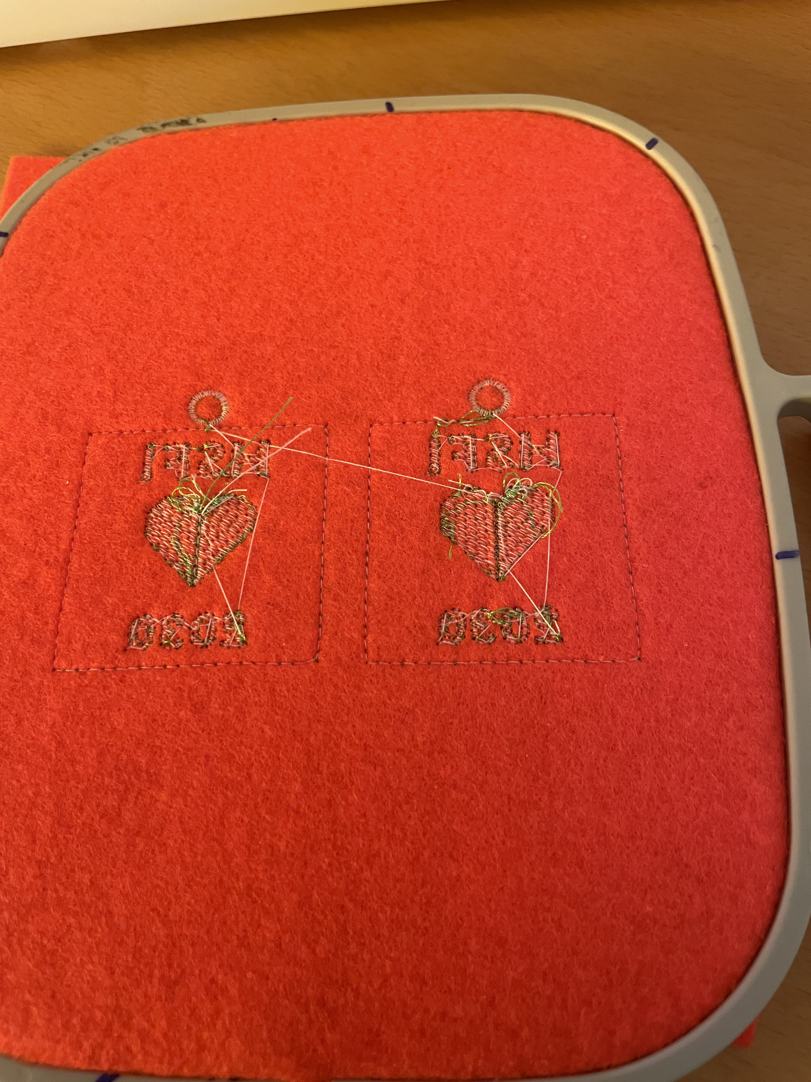
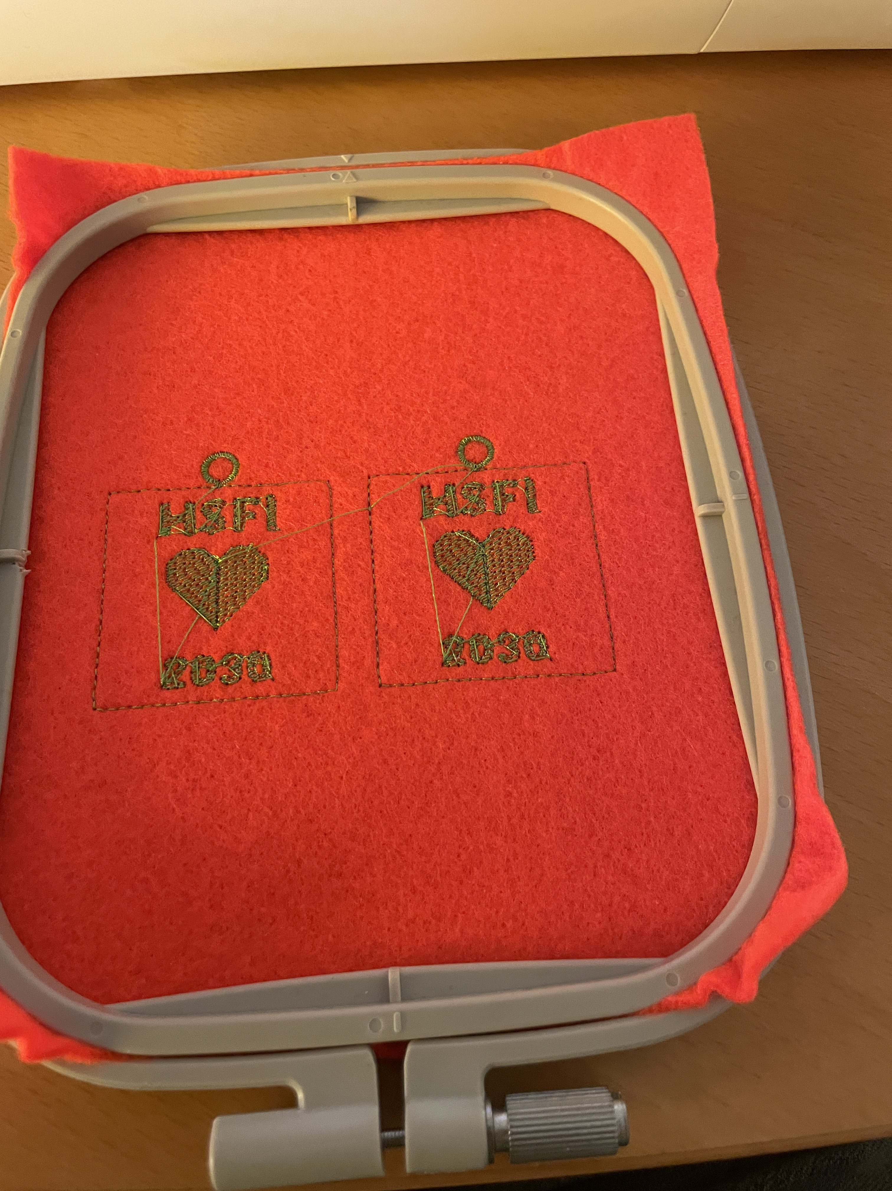
Let’s look at the embroidered results
Combined, result after the first part

Slide 15
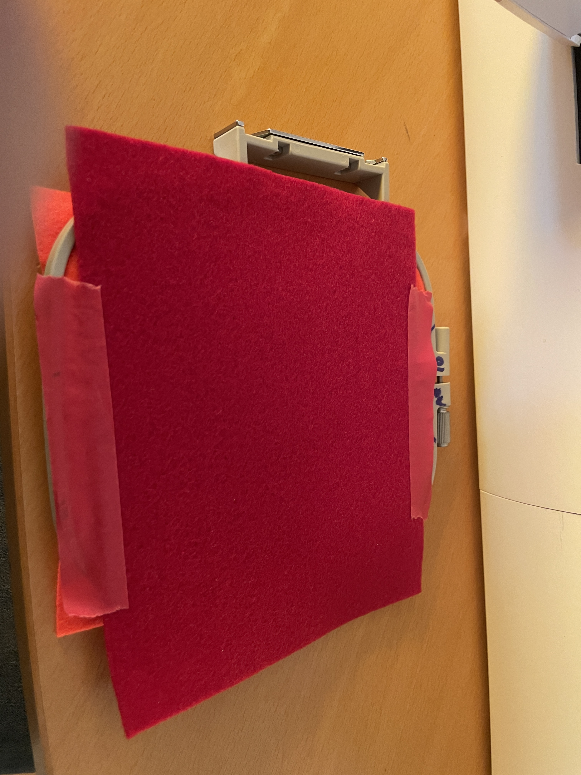
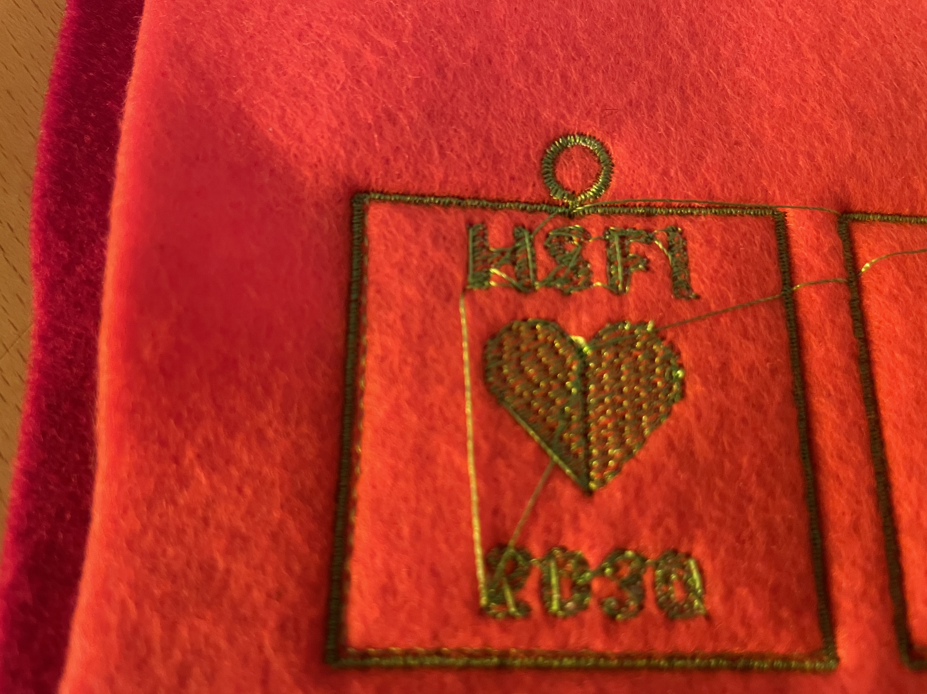
Doing the back
This is a little off. Because putting felt at the bottom influences the top felt for a fraction of a mm

Slide 16
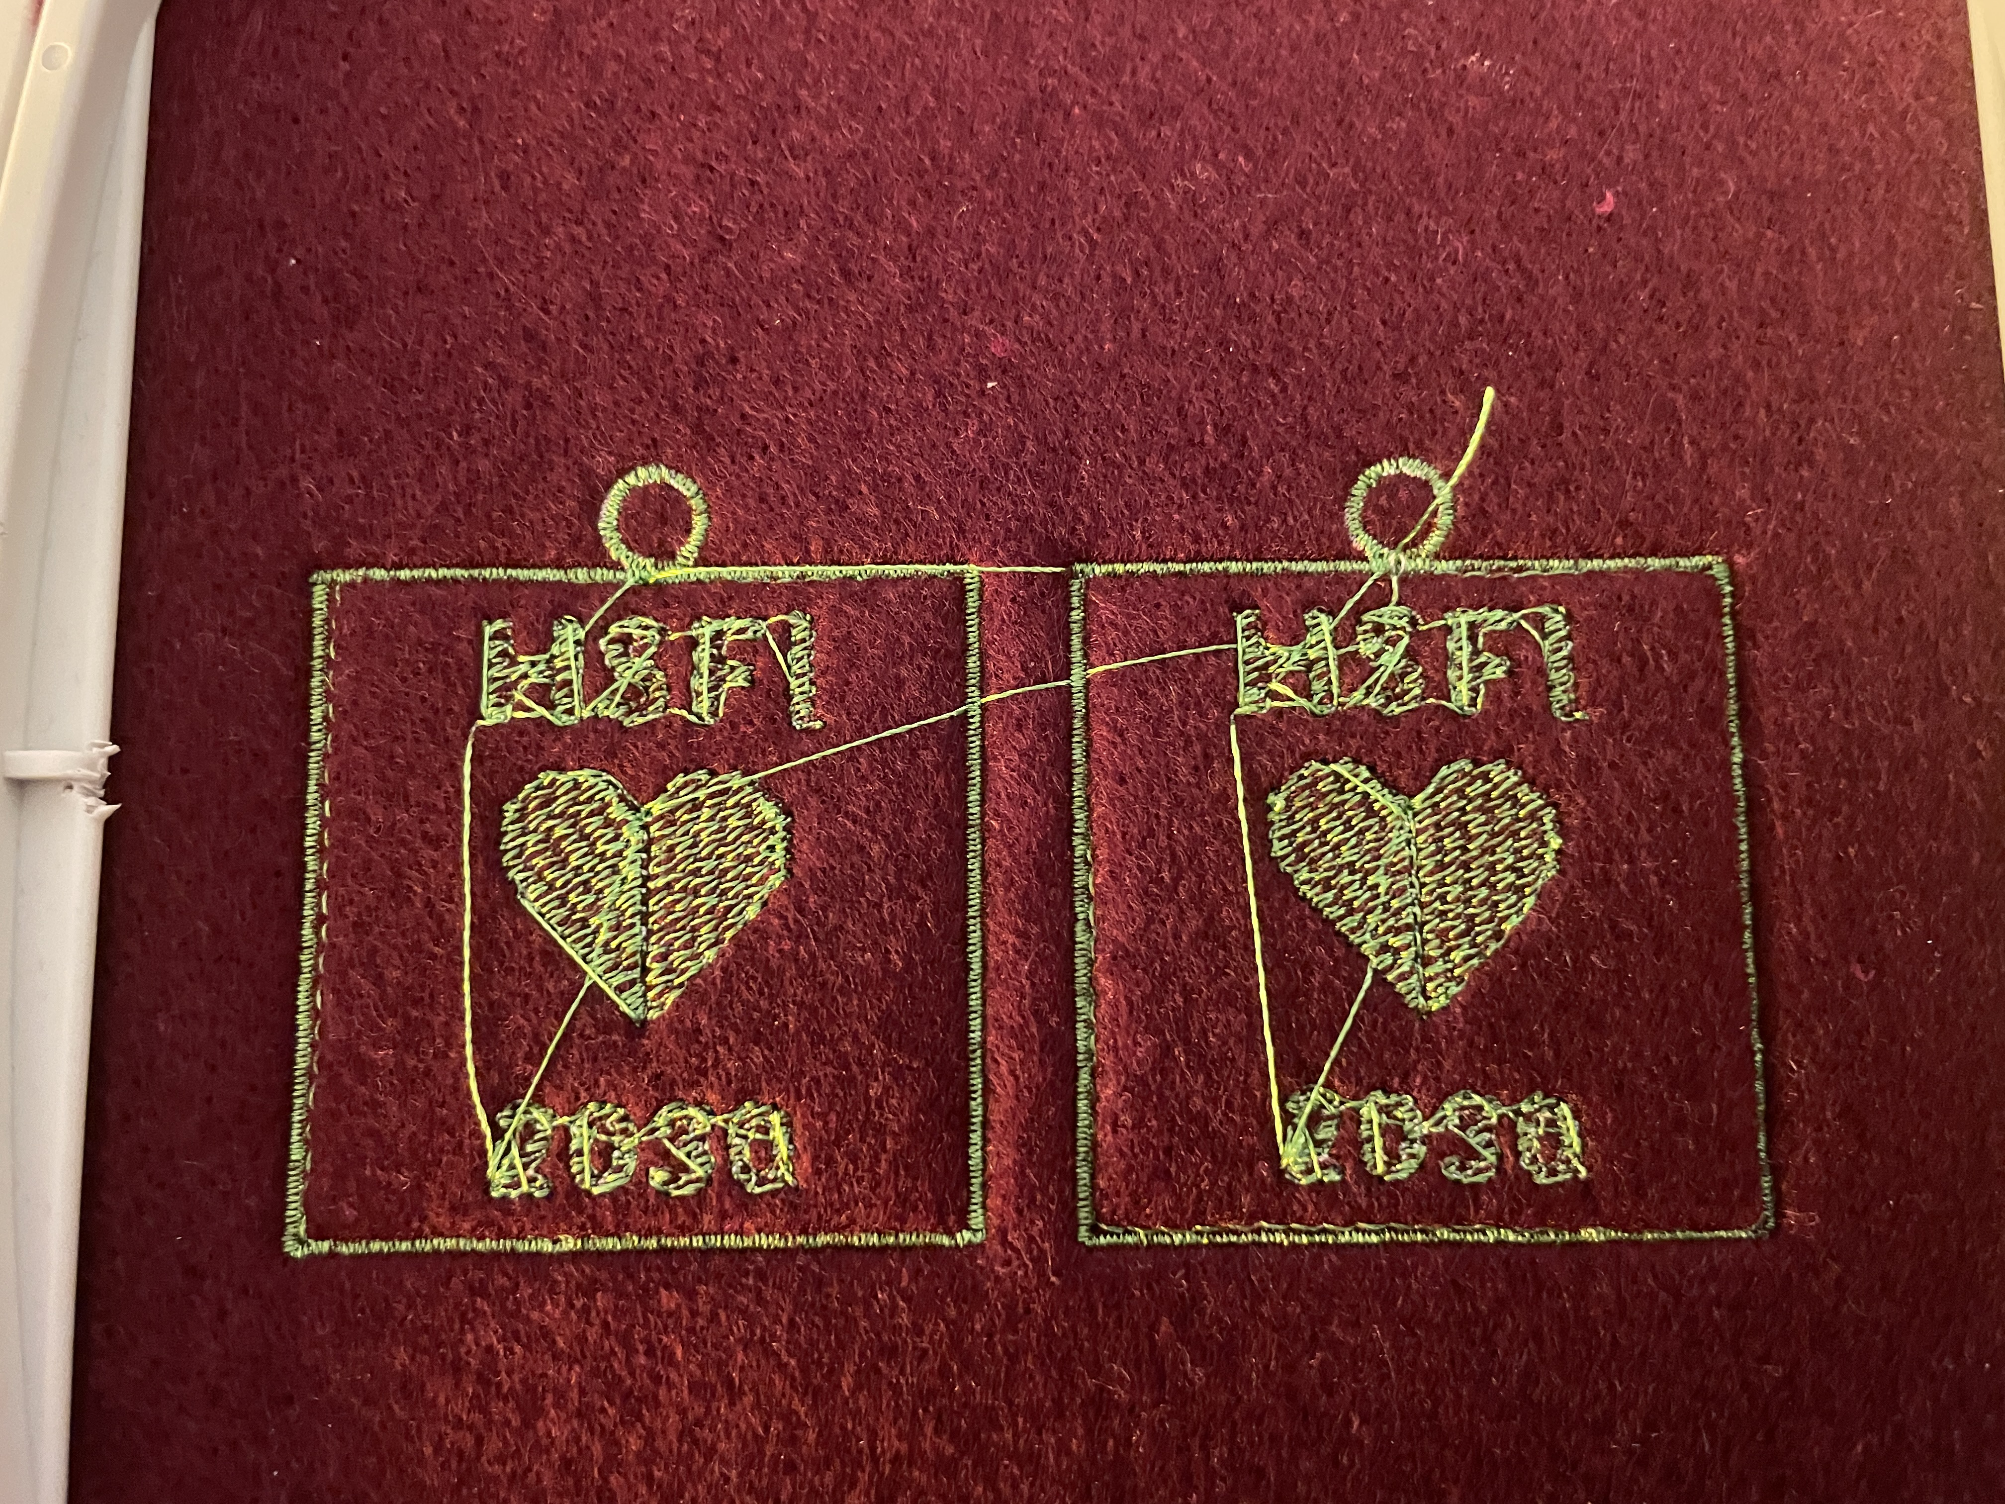
Alignment of first and second design
Perfect alignment without doing anything on the machine.
Only a few issues of a fraction offset like in the combined case due to the fabric that was put on the back.

Slide 17
Questions
Is there a need for the box in the first design?
The first design has multiple colors. Well prepared for a multi needle machine
  On a single needle machine like mine I would have to change the color many times (e.g. 4 times per sub-design)
This can be made better, let’s however first draw conclusions from what was done so far

Slide 18
Conclusion
For repeat designs, make one design with only relative coordinates
  Then use nested for loops to create as many as you want
  To reduce jump stitch length, consider how you jump from row to row
  And look at the design to even further reduce jump stitches in the single design
  The example works well for single color thread designs or for multi-needle machines
When designing for backing material applied half way
  Use the same program, but use a flag to include or exclude or change parts of the design
  Use color change to stop the machine and then apply the backing and potentially load the second design
  When splitting into two separate designs, make a bounding box around the designs that are exactly equal to let the embroidery machine position both designs in exactly the same position.
    However, the result may be a fraction of a mm off due to the fabric on the back influencing the fabric on the front.

Slide 19
A failed attempt: Avoid the box in the first design
Idea: do not sew the box in the first design, but make jump stitches instead to still record the positions for the bounding box

Slide 20
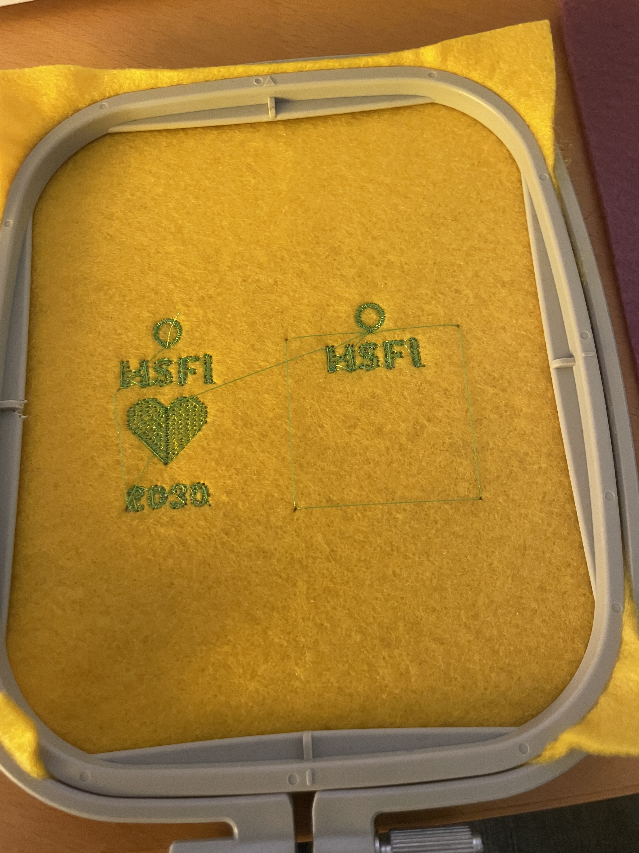
Result: not good
Jump stitches do not only move the needle, but makes a stitch as well
At the left box, the jump
stitches are made, but the
thread retracts.
At the right box it makes
actual stitches with long
jumps

Slide 21
Next steps
Avoid the box in the first part
  Not needed as it will anyway disappear under the satin stitch of the second part
Make it selectable that in the first part the patterns for a specific color of all sub-designs can all be embroidered together (color sorting)
Find out why the ring is a few steps off in several of the sub-designs (must be a bug somewhere that I cannot find)
Write documentation
Anything else desired by anyone?

Slide 22
Questions?

Slide 23
Where to find the files?
Original design:
https://turtlestitch.org/users/susanettenheim/projects/2030_HSFI
Modified design:
https://turtlestitch.org/users/HansDeJongEhv/projects/2026_hsfi2026_2_boundinBox_WithOptions
This presentation:
https://github.com/hansdejongehv/TSUSB/blob/main/Miscellaneous/Repeated%20designs%20and%20backing.pdf

